Slide 1
DBMS
Stored Procedures

Slide 2
What is Stored Procedures
Using stored procedures is an easy way to save time from frequently writing the same lines of code and also expedite the call and execution of the desired query.
An SQL Server Stored Procedure is a logical collection of statements or queries packaged together to perform a particular task, repeatedly.
You do not have to write the statements repeatedly and it saves not just time but also other server resources.

Slide 3
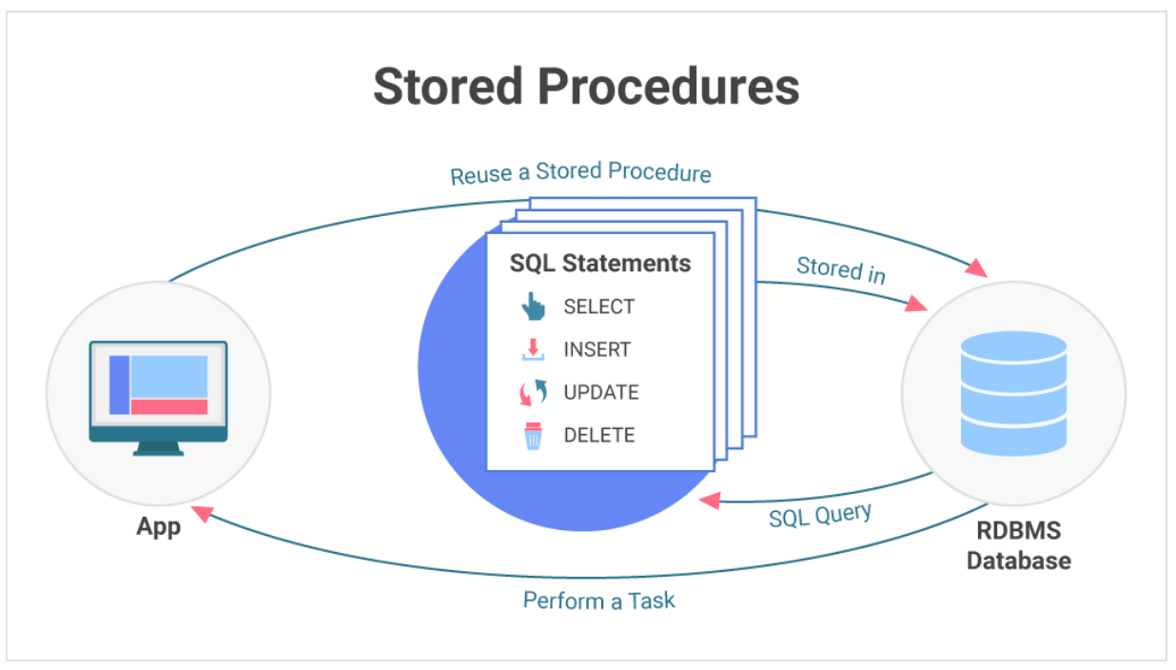
What is Stored Procedures

Slide 4
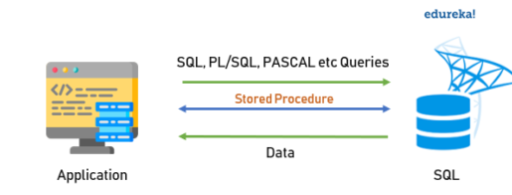
What is Stored Procedures

Slide 5
Advantages of Stored Procedures
Stored procedures are compiled only once during its creation, and it is cached in the server. Therefore, repeated compilation is not required during execution of the procedure, thereby increasing the speed of execution. However, if any updates are made in the procedure then it will be re-compiled.
One very useful accepts of using a stored procedures is the security cover it provides to its data source.
Since there are no direct accesses to the tables, it prevents unauthorized manipulation of records inside the tables. A properly written procedure acts as a solid deterrence to SQL injections.
Reduce the Network Traffic: Multiple SQL Statements are encapsulated in a stored procedure. When you execute it, instead of sending multiple queries, we are sending only the name and the parameters of the stored procedure

Slide 6
Advantages of Stored Procedures
The syntax to create a MySQL Stored procedure is the following:
Create Procedure [Procedure Name]
([Parameter 1], [Parameter 2], [Parameter 3] )
Begin
SQL Queries..
End

Slide 7
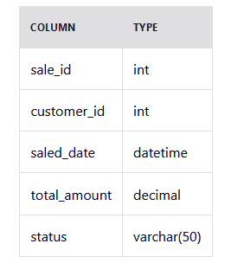
When to use Stored Procedures
Let's consider an e-commerce website.
we have the functionality to generate sales reporting.
We have a table called sales.
By creating stored procedures that aggregate and summarize sales data, we can optimize the reporting process.
These procedures can calculate metrics like total sales, top-selling products, or revenue by category, making it easier to retrieve valuable insights quickly and efficiently.

Slide 8
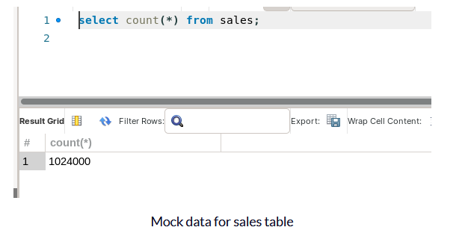
When to use Stored Procedures

Slide 9
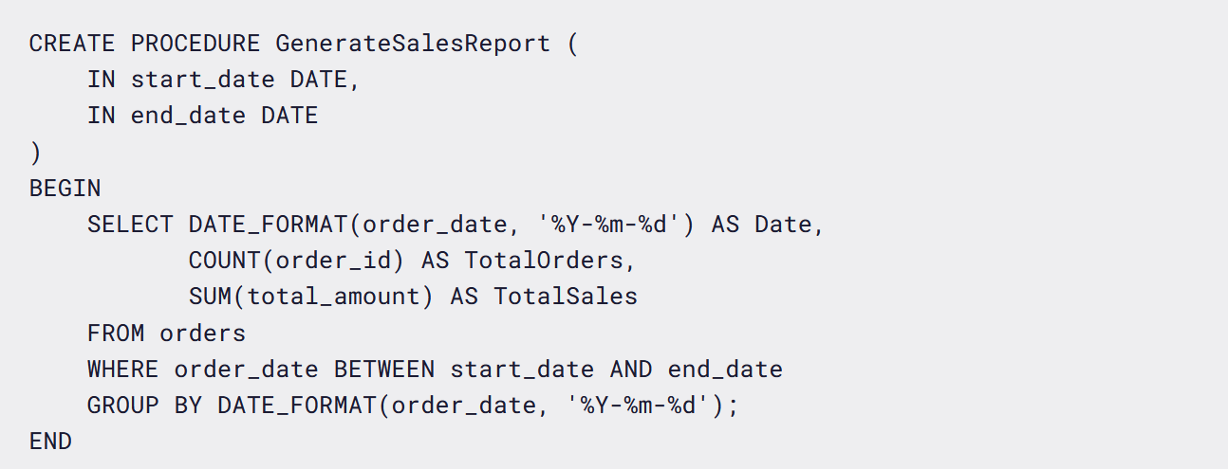
When to use Stored Procedures

Slide 10
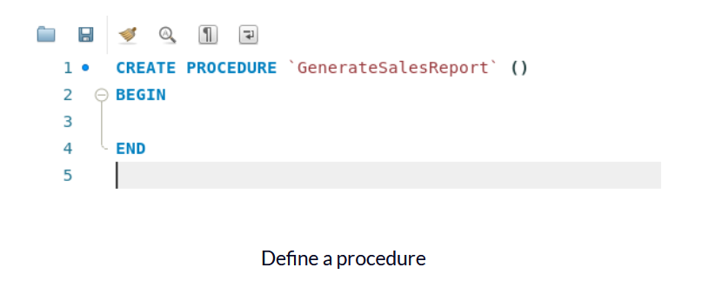
Building Blocks of Stored Procedures
Procedure Name
Every stored procedure has a unique name that identifies it within the database. The name should be descriptive and relevant to the procedure's purpose

Slide 11
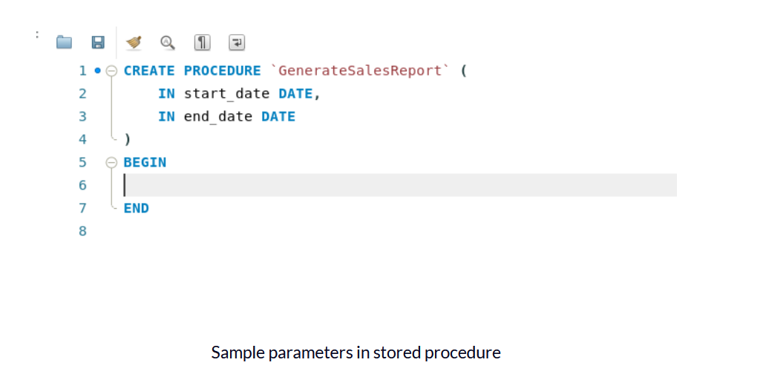
Building Blocks of Stored Procedures
Parameters
Stored procedures can have input parameters that allow you to pass values into the procedure at runtime.
We define start_date and end_date as our input parameters.

Slide 12
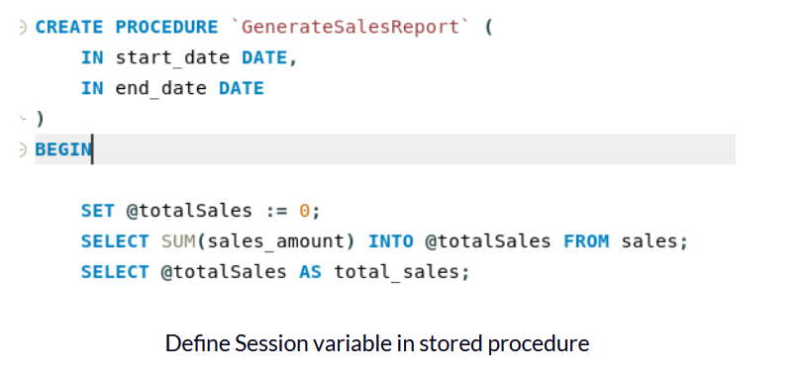
Building Blocks of Stored Procedures
Variables
Variables are used to store and manipulate data within the stored procedure. They can be declared and assigned values as needed.
Session Variables
Session variables in MySQL are prefixed with the @ symbol (for example @variable_name). These variables are associated with the current session or connection and retain their values throughout the session until they are explicitly changed or the session ends. (Like Global Variable)

Slide 13
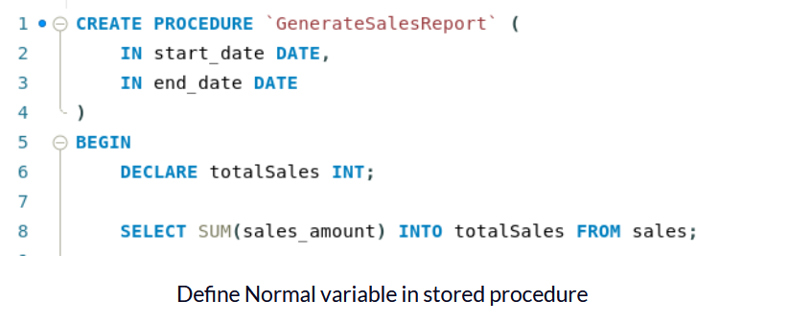
Building Blocks of Stored Procedures
Regular Variables
Regular variables, also known as local variables, are declared using the DECLARE keyword within the scope of a stored procedure.
Unlike session variables, regular variables do not have the @ prefix (for example variable_name).
They are temporary and exist only within the block of code where they are declared.

Slide 14
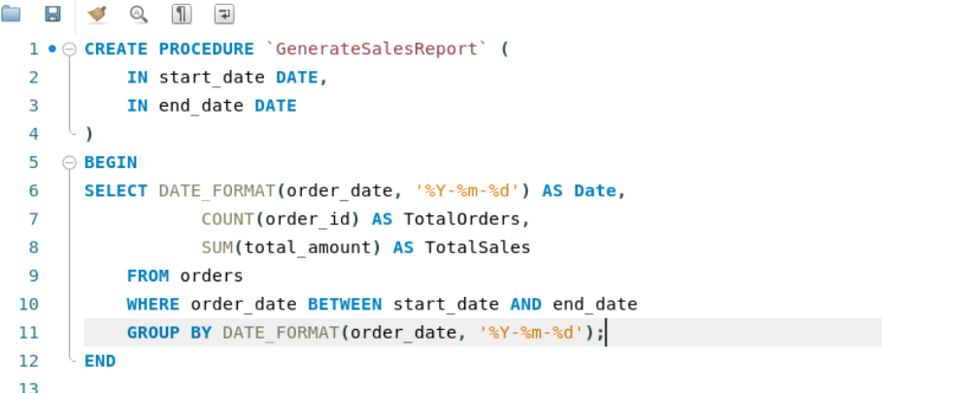
Building Blocks of Stored Procedures
SQL Statements
The core functionality of a stored procedure is defined by SQL statements.
These statements can include SELECT, INSERT, UPDATE, DELETE, and other SQL commands to interact with the database

Slide 15
Building Blocks of Stored Procedures
Procedure Call
To execute the stored procedure and generate a detailed sales report for a specific date range, we can use the following syntax:

